Slide 1
EagleSat Flight Operations
Mo Sabliny
Dr. Yale
Arizona Space Grant Symposium
April 12, 2014

Slide 2
EagleSat
EagleSat is ERAU Prescott’s first satellite program
Developed by undergraduate students and mentors
Mission
Measure orbital decay
Solar radiation effects on CPU memory

Slide 3
Flight Operations Objective
Determine the orbital model
Eclipse calculations
Pass times
Predict orbital decay
Calculate radiation and effects
Develop a mission timeline
Develop a best fit orbital decay model from data (post flight)

Slide 4
Flight Dynamics
STK vs. MATLAB
STK allows for quick results by entering multiple initial conditions
MATLAB allows for an in depth analysis of an orbit
Use for both STK and MATLAB for accuracy

Slide 5
STK Results
Classical Orbital Elements
Orbital Element | Value
Semi-Major Axis (km) | 6795.746
Eccentricity | 0.000281
Inclination(deg) | 51.652
Argument of Perigee (deg) | 37.68
RAAN (deg) | 222.166
Mean Anomaly (deg) | 302.797

Slide 6
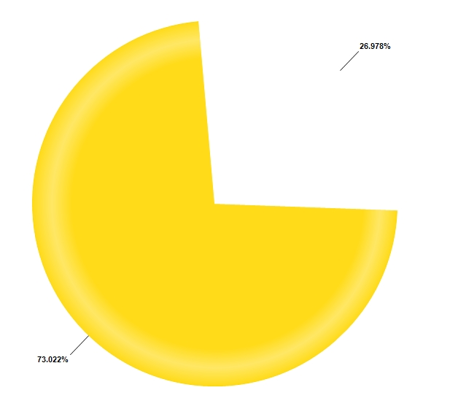
STK Results
Percentage in Sun and Eclipse
Earth

Slide 7
STK Results
Downlink Opportunities
About 60 opportunities per week
Shortest: 3.75 minutes
Longest: 8.67 minutes
About 38 opportunities per week during school hours

Slide 8
MATLAB Orbit Propagation
Utilize ode45 function with a few possible models
Relative 2-Body problem
Assumes Earth doesn’t rotate
Assumes Earth is spherical
Non-spherical Earth 2-Body problem
N-body problem
Takes into account gravitational effects of nearby bodies
Propagating the state vector through each time step
State vector is the position and velocity vector {x,y,z,vx,vy,vz}
Calculate the differential state vector {vx,vy,vz,ax,ay,az}

Slide 9
Eclipse Calculations
Antumbra
EagleSat
Umbra
r_{sat/e}
R_{s}
θ_{u}
R_{e}
θ_{e}
r_{e/s}
Sun
h_{u}
Earth
θ_{p}
Θ_{e} = cos⁻¹((r_{sat/e}·r_{e/s})/(r_{sat/e}*r_{e/s}))
Penumbra
Θ_{u} = tan⁻¹(R_{e}/h_{u})
Θ_{p} = π – tan⁻¹(r_{e/s}/(R_{s} + R_{e})
du = ((h_{u} * sin(Θ_{u}))/sin(Θ_{e} + Θ_{u})) = distance to umbra cone edge along satellite

Slide 10
Eclipse Calculations
These calculations determine where the satellite is in ecliptic terms
Umbra -Total Eclipse (No Sun)
No Eclipse (Full Sunlight)
Penumbra, Antumbra - Partial Eclipse (Fraction of the Sun)
Further calculations to calculate the fraction of the Sun the satellite sees

Slide 11
Passes
EagleSat
θ_{E} = sin⁻¹(Z/r_{SAT/GS})
r_{SAT/GS}= {S;E;Z}
When θ_{E} is greater that 0°, and less than 180° the satellite can be “seen”
Not always the case, when land formations, buildings, etc. are taken into account
Ground Station
θ_{E}
Earth

Slide 12
Future Work
Effects of Radiation on lifetime of satellite:
Solar Radiation, Earth Radiation, Earth Albedo
Attempt to model orbital decay
Establish a mission timeline that will incorporate each aspect of the orbital model
Determine a model to best fit data from flight
Statistical Determination

Slide 13
Conclusion
These different aspects of an orbital model contribute to the development of a mission timeline
Prepares the EagleSat team for what to expect when considering everything that can affect the satellite

Slide 14
Acknowledgements
Mentors:
Dr. Gary Yale
Dr. John Post
Jack Crabtree
Organizations:
Arizona Space Grant Consortium
Ignite

Slide 15
Questions?
Thank you.

